Slide 1
The longhorned tick on Staten Island

Slide 2
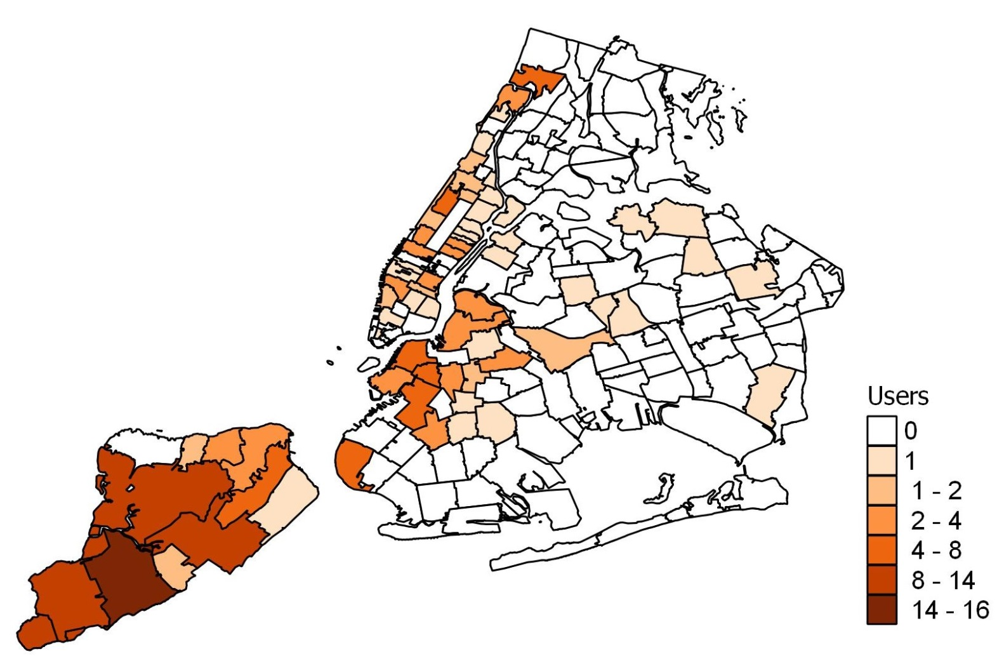
From the Tick App users on Staten Island
Staten Island
83 users from Staten Island
20 tick encounters were reported, 5 on self
All Tick App Users

Slide 3
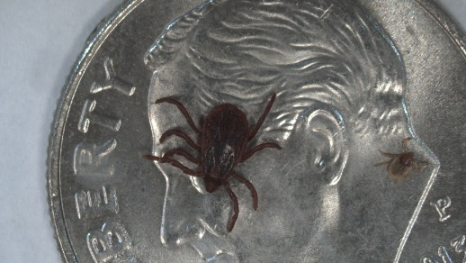
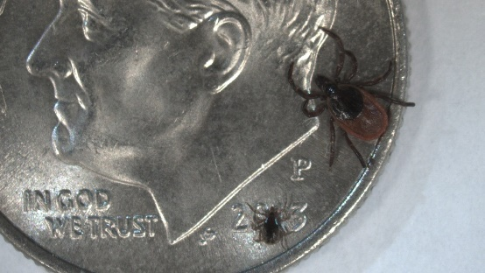
How to Avoid Tick-Borne Diseases:
Identification, Prevention, Response
Talk Order
  Tick Prevention Strategies
  How to Identify and Remove Ticks
  Live Presentation

Slide 4

or….
Be Like Derek Jeter
Photo by Jim McIsaac- Getty Images

Slide 5
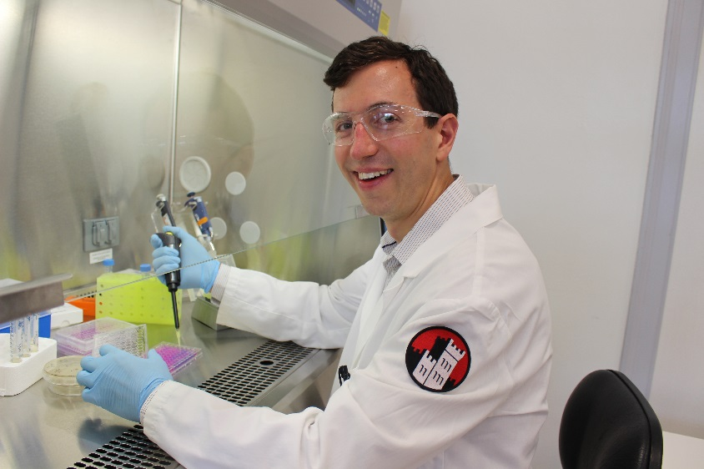


Christopher Pappas, Ph.D.
Molecular Microbiologist
  Fellow, Institut Pasteur
    Unité de Biologie des Spirochètes
  Ph.D. Microbiology and Immunology
    New York Medical College
Academic history
  Manhattanville College, New York Medical College
  General Biology, Parasitology, Molecular Biology, Medical Microbiology, Nutrition, Genetics, Research Mentor
Research Interests
  -Enzootic and Vector-Borne diseases
  -Lyme disease and Leptospirosis
  -(Ixodid) Hard Ticks

Slide 6
How does someone typically contract a tick-borne disease?
Come into contact with a tick
Have the tick attach
Have the tick attach for a prolonged period
  The tick has to carry a pathogen within it (burdened)
  The pathogen has to have been transferred to you
You do not follow up with a doctor for prophylactic care
Notes:
So does that sound easy?
In a study in Westchester, only 20% of nymphs were positive for the lyme bacterium, only 25% of adults
https://aem.asm.org/content/69/8/4561.long

Slide 7
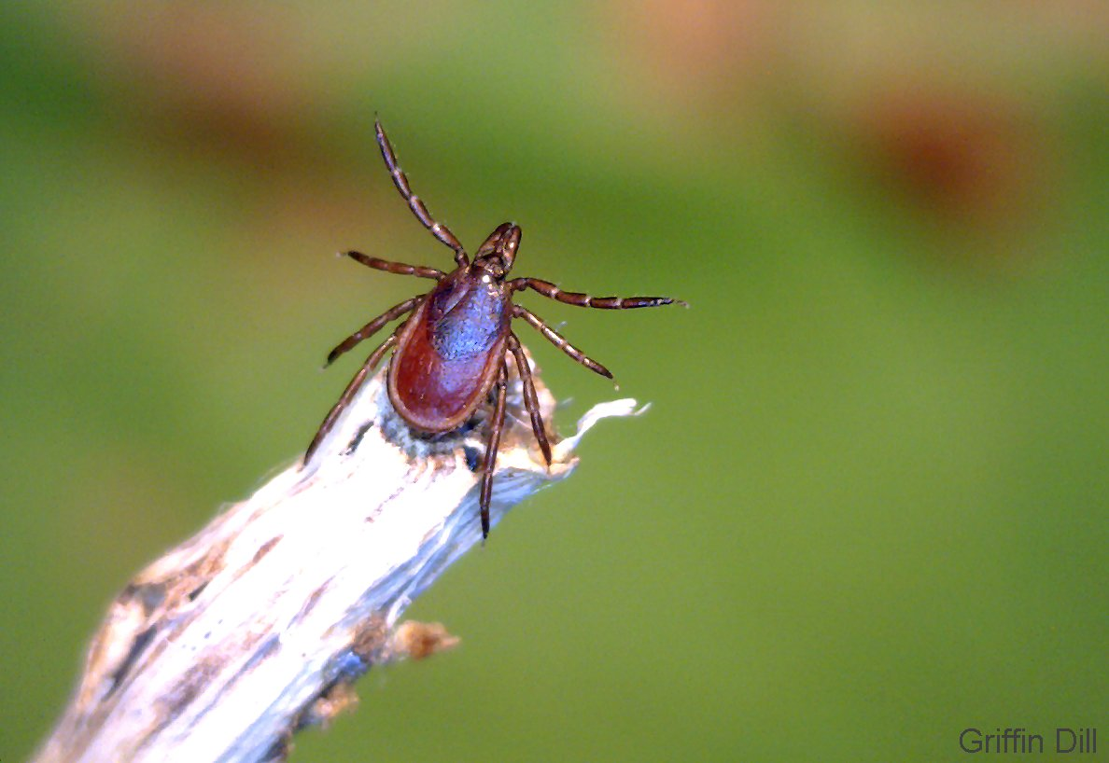
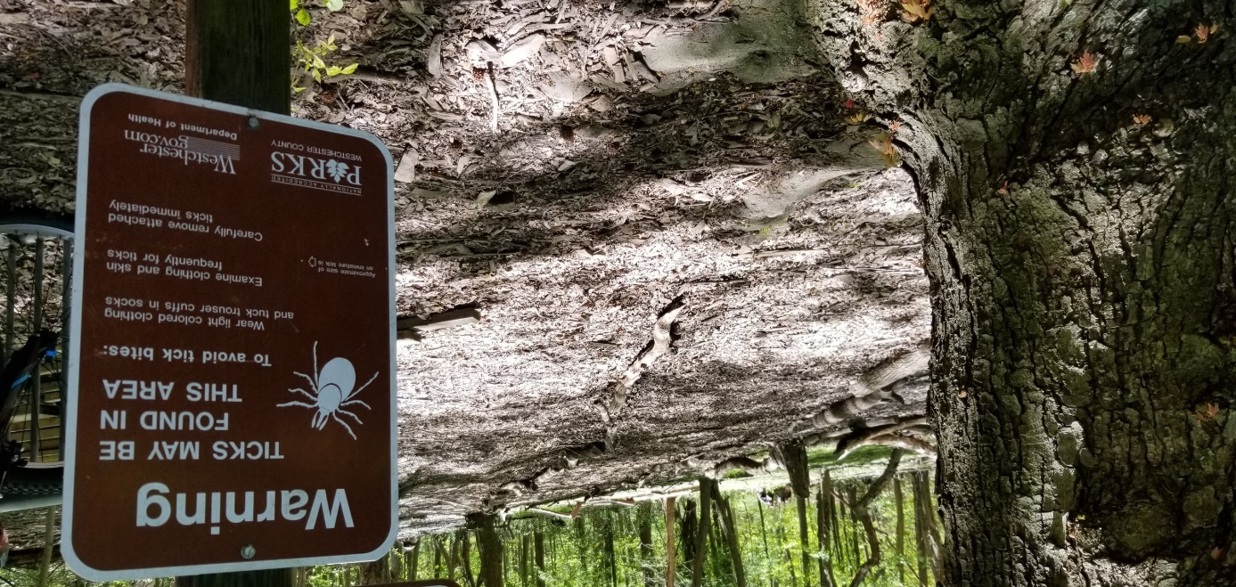
What Attracts a Deer Tick?
Deer Ticks are attracted to many things
  Animal odor
  Skin and hair texture
  Vibrations
  Variance in temperature
  Carbon dioxide
Deer ticks avoid areas that put them at risk of drying out
  Dry/ exposed areas
  Very sunny areas
  Windy areas
Deer ticks seek out
  Tall(ish) grasses
  Leaf litter and piles
  Wind protected areas
  Shaded areas
Notes:
Most ticks cannot see so rely on other indicators a host is present
Areas near dens of hosts (for nidicolous species)
Questing behavior is called ambush strategy

Slide 8
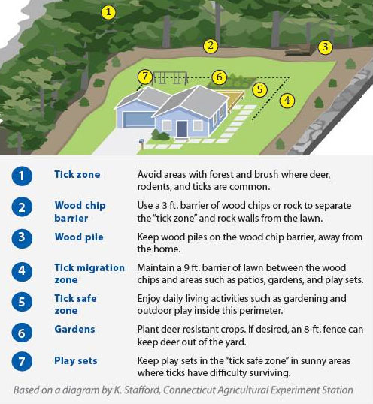
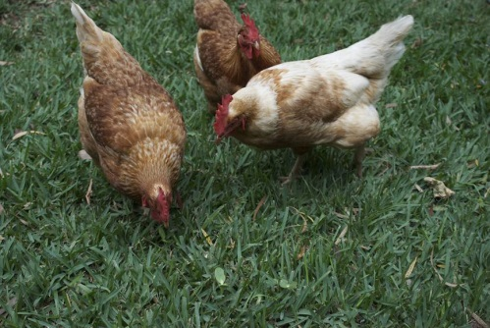
How To Prevent Being Bitten by a Tick
Lawn Care
  Backyard Chickens?
Watch out when stopping on a highway/ rest area
Wear lighter Clothes when hiking/ yard work
  Tuck pants into socks- treat with permethrin
  Clean clothes by checking then drying in a dryer
Take care when walking a pet
Showering Promptly
Daily Tick Checks
EPA approved repellents
cdc.gov
Photo by Lindsay Holmwood
Notes:
https://newyork.cbslocal.com/2018/07/27/backyard-chickens-ticks-salmonella/
It’s not a fashion show
Permethrin- used to treat lice

Slide 9
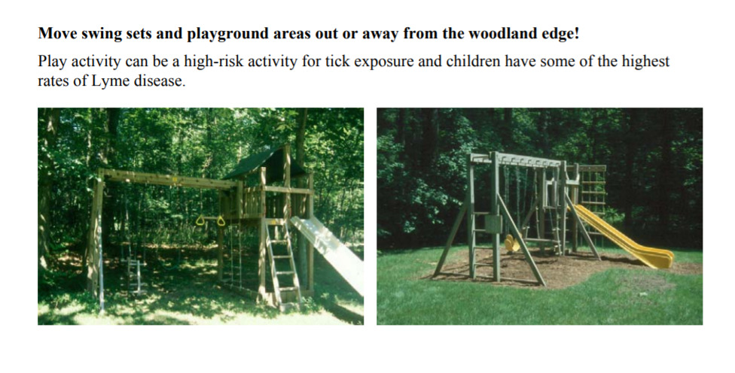



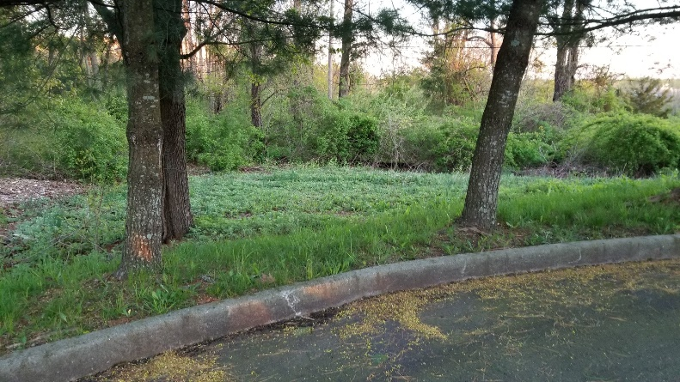

Know Where Ticks Prefer to Quest/ Reside

Slide 10
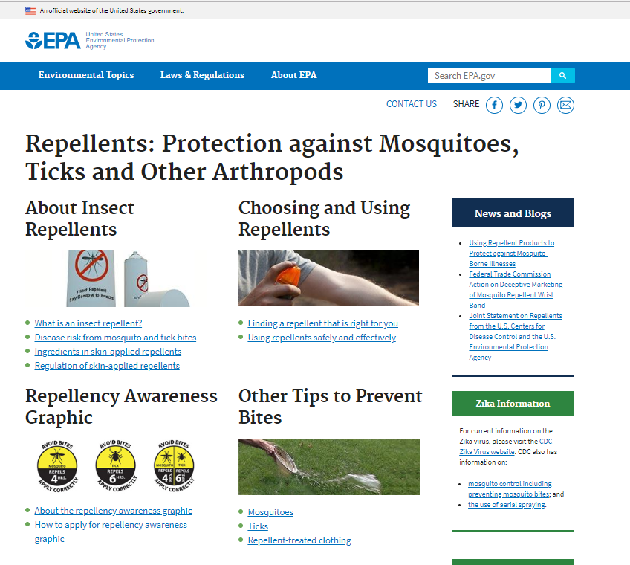
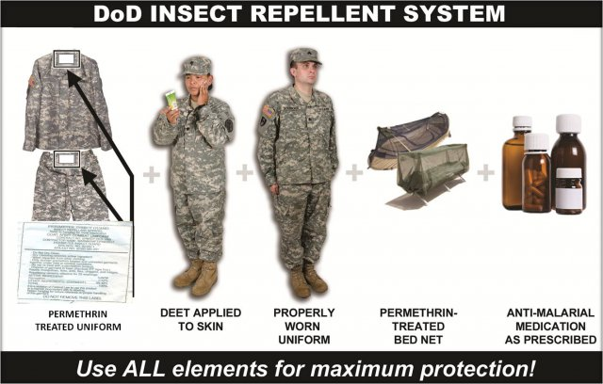
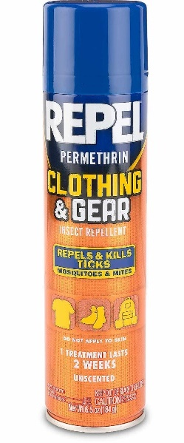
EPA- Approved Repellents
army.mil

Slide 11
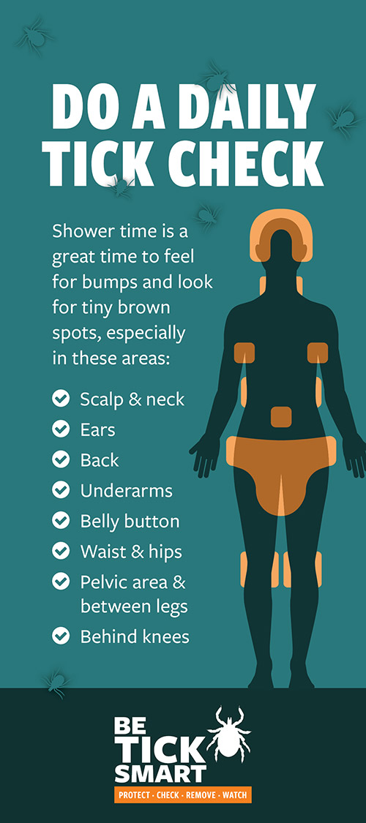
Tick Check Hotspots
…Don’t forget between the toes!
Healthyvermont.gov

Slide 12
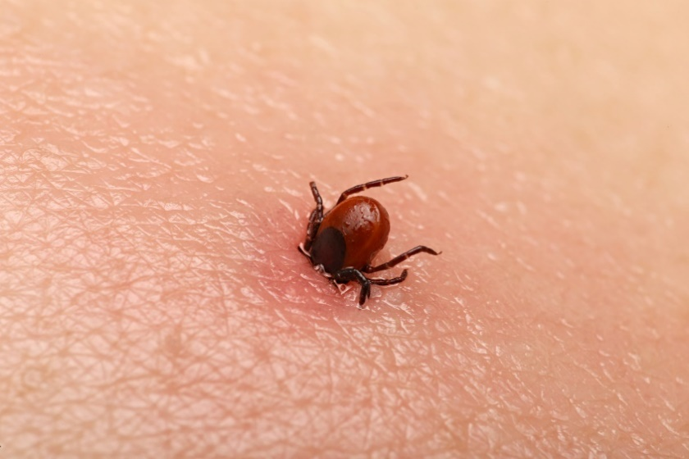
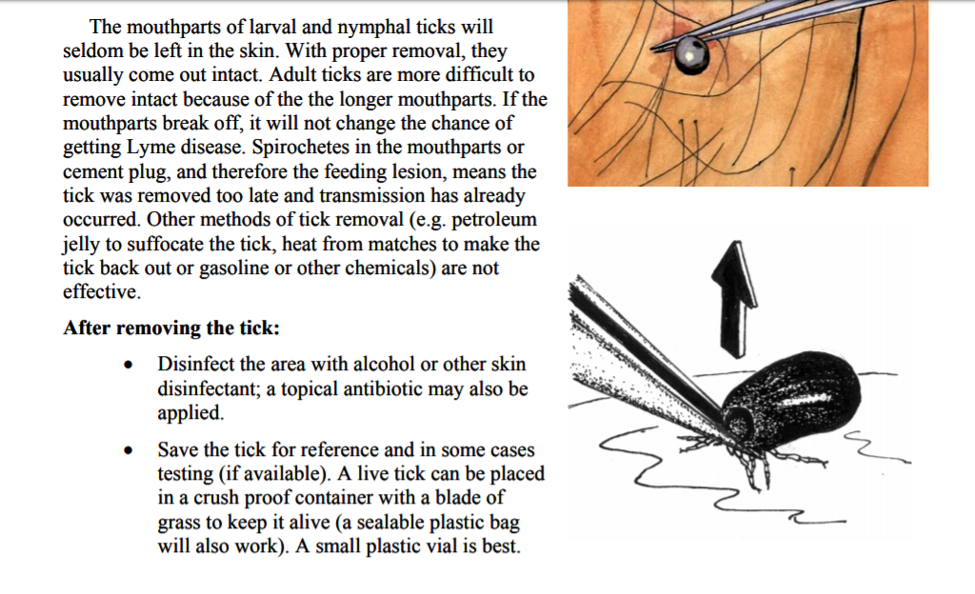
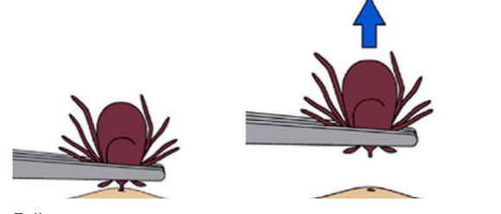
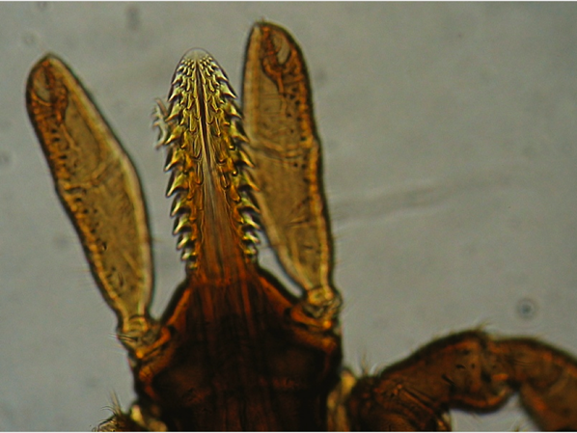
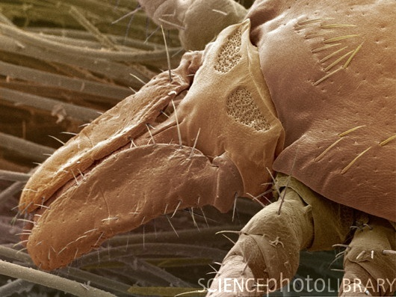
How to Remove a Tick
Only One Method:
  Forceps at the mouthparts
  Controlled and single movement perpendicular to the skin
Do NOT
  Use a match
  Use jelly/ olive oil
  Use nail polish
  Anything else
  Increases risk of transmission of diseases

Slide 13
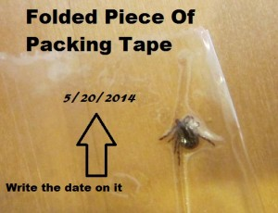
Keep the Tick!
Can be placed in a mason jar, stuck to a piece of tape
Follow up with a doctor, report any symptoms
  Try to identify the tick https://www.cdc.gov/ticks/geographic_distribution.html

Slide 14

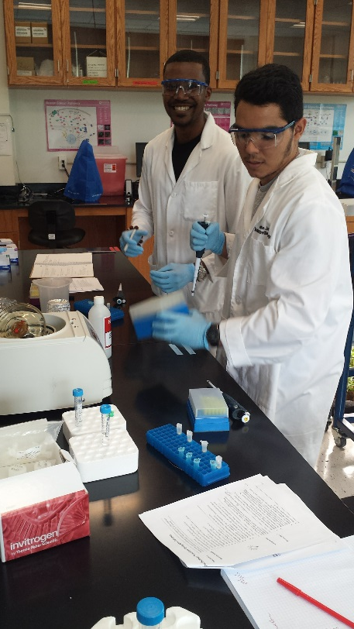

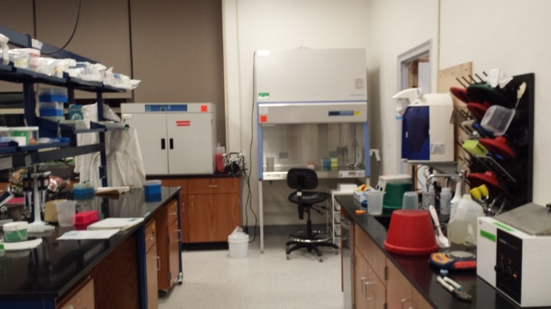
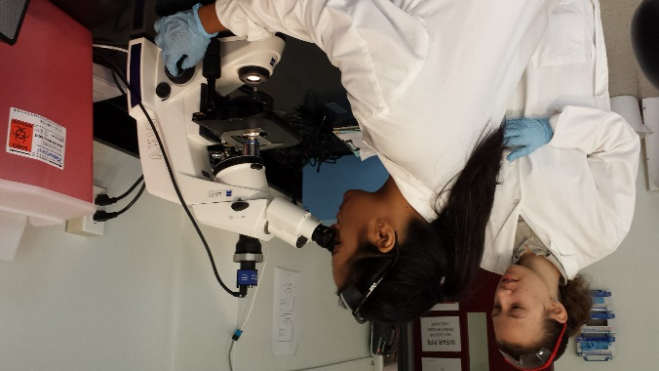

Thank You For Your Time!
For More Info- Use Peer-Reviewed and Government Resources: www.cdc.gov
Lyme Clinic at Westchester Medical Center: (914) 493-TICK
E: christopher.pappas@mville.edu
P: (914) 323-1276
@BeyondOrganix
Notes:
Philip is at Mt. Sinai

